Slide 1

ANIMAL CLASSIFICATION USING FACIAL IMAGE SCORE LEVEL FUSION
Session: 2019-2023
Presented By:
Ajay Kumar (19006380110004)
Aloukik Attrey (1900680110007)
Under the Guidance of:
Mr. Rakesh Sambyal
Department of Information Technology
Meerut Institute of Engineering & Technology, Meerut (U.P.)
Notes:
₁

Slide 2

Presentation Outlines
Introduction
Research/Study Gap
Problem Statement
Objectives of the study
Methodology
DFD/Flow chart related to study
Hardware & Software to be used
References

Slide 3
Introduction
Animal recognition and classification is an important area which has not been discussed rapidly. Animal classification which relies on the problem of distinguishing images of different animal species is an easy task for humans, to distinguish them automatically. Animal have flexible structure that could may appear under different illumination condition, viewpoint and scales. There are attempts of apply recognition method on images of animals but the specific problem of animal categorization has recent attracted limited interest.
Many existing method showing promising results for humans are

Slide 4
Introduction Contd.…
Recognition cannot properly represent the diversity of animal classes with complex intraclass variability and inter-class similarity. There are several kinds of approaches for solving this problem with each one having its advantage and disadvantage. Proposed approach constructs complex features which represents and discriminates sample image better but creating such a feature is complicated and it is problem dependent. Instead of using complex representation, the information is used for decision making.

Slide 5
Problem Statement
To constructs complex features which represents and discriminates sample image better but creating such a feature is complicated.
Increasing the size of feature space also causes increased problem computation cost.

Slide 6
Objectives of the study
Our main objective is to develop a system which will use computer vision approaches of the classification of animal.

Slide 7
Methodology
According to the success rate of using score-level fusion in multimodal biometric recognition systems, it is believed that accuracy can be improved when the information of two different types of classifiers are consolidated. Due to large inter-class similarity and intra-class variation, we need to perform fusion of two different kinds of feature descriptors. Appropriate score-level combination of CNN and other simple features can achieve even higher accuracy than applying CNN alone. In our proposed method, we performed score-level fusion of features that are extracted from two different descriptors.

Slide 8
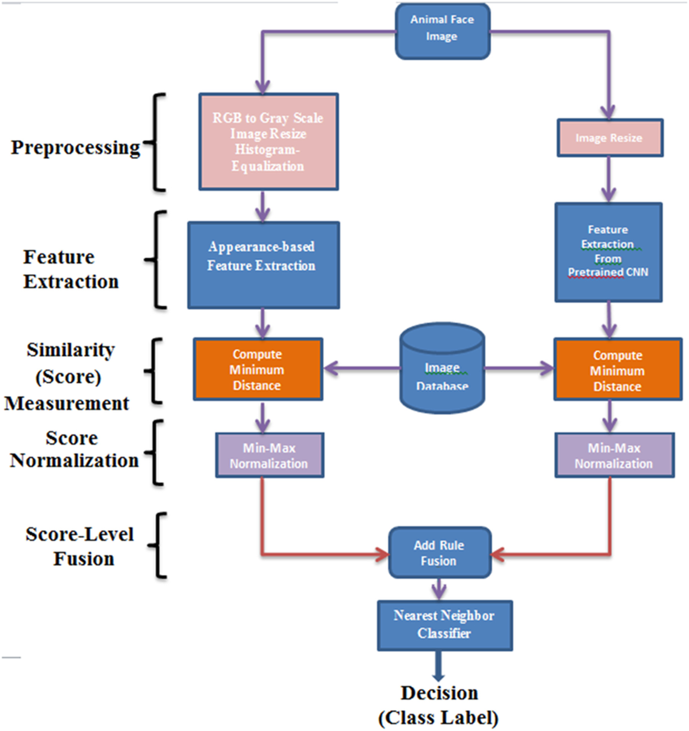
Methodology contd...

Slide 9
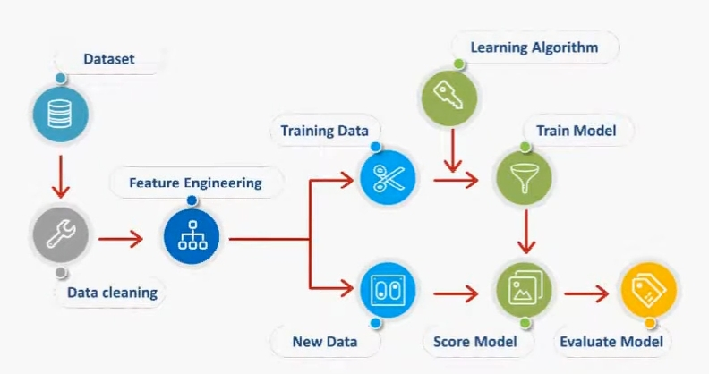
DFD/Flow chart of the study
Architecture

Slide 10
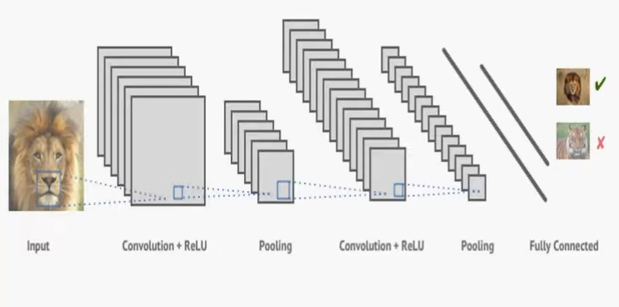
High Level Diagram

Slide 11
Hardware Requirement
System : Pentium IV 2.4Ghz
Ram : 4 GB
Hard Disk : 500 GB
Any desktop/Laptop system with above configuration or higher level.

Slide 12
Software Requirements
Operating System : Windows XP/7/10
Coding Language : Python
IDE : Jupiter Notebook

Slide 13
References
IET standard paper
Elson, J., Douceur, J., Howell, J., et al: ‘ Asirra: a CAPTCHA that exploits interest-aligned manual image categorization’. Proc. ACM Conf. Computer and Communications Security (CCS), Alexandria VA, USA, 2007, pp. 366– 374Google Scholar
Marcialis, G., Roli, F.: ‘ Score-level fusion of fingerprint and face matchers for personal verification under stress conditions’. 14th IEEE Int. Conf. Image Analysis and Processing ICIAP, DC, USA, 2007, pp. 259– 264

Slide 14
Reference contd…
Elmir, Y., Elberrichi, Z., Adjoudj, R.: ‘ Score-level fusion based multimodal biometric identification (fingerprint & voice)’. 6th Int. Conf. Sciences of Electronics, Technologies of Information and Telecommunications, Sousse, 2010, pp. 146– 150
Names of Websites referred : https://ietresearch.onlinelibrary.wiley.com/doi/full/10.1049/iet-cvi.2017.0079

